Slide 1
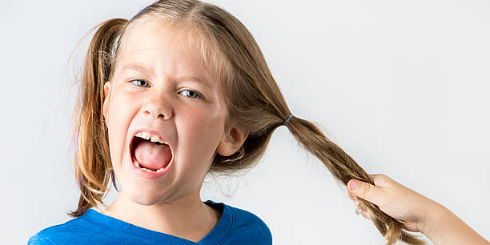
Grabbing and Touching Social Story

Slide 2
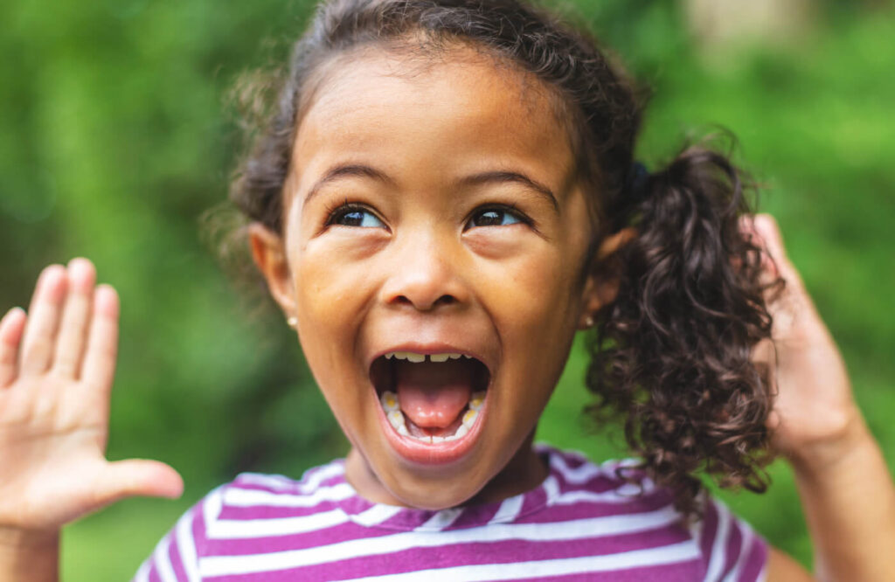
Sometimes when I feel excited…

Slide 3
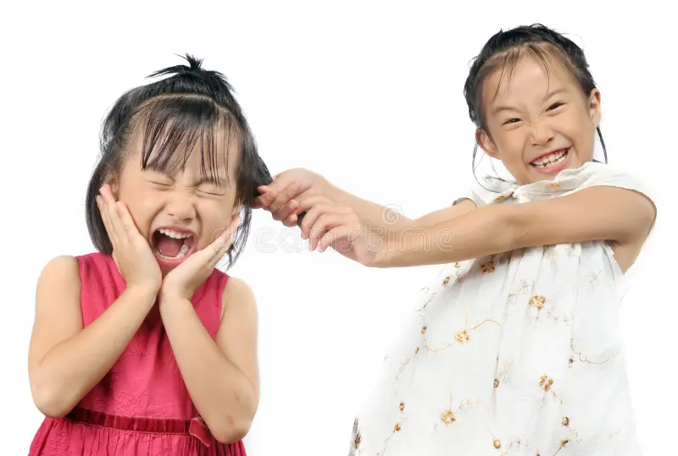
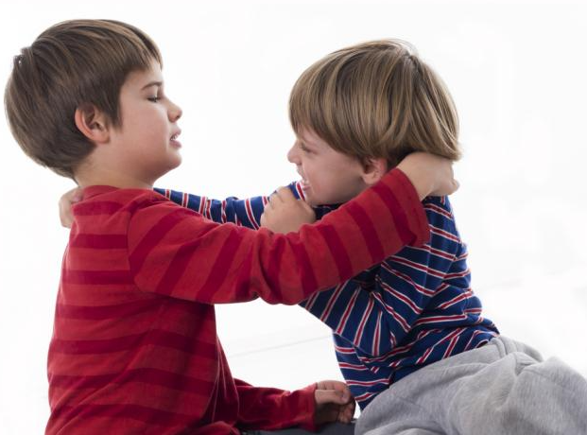
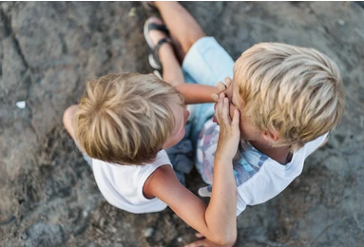
I may pull my friend’s hair or grab my friend

Slide 4
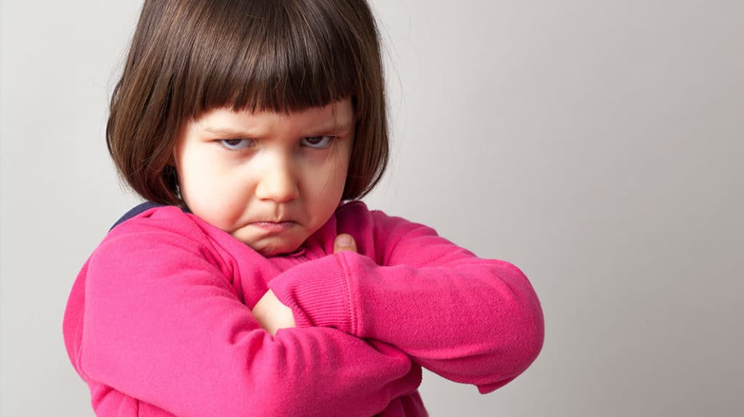
Sometimes when I feel angry…

Slide 5
I may pull my friend’s hair or grab my friend

Slide 6
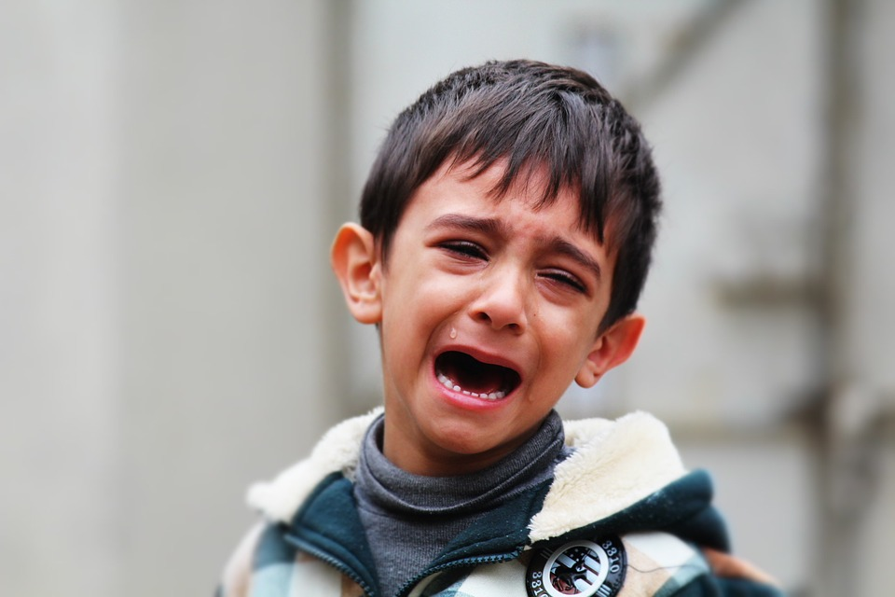
Sometimes when I feel sad…

Slide 7
I may pull my friend’s hair or grab my friend

Slide 8
But grabbing or touching my friend is NOT okay

Slide 9
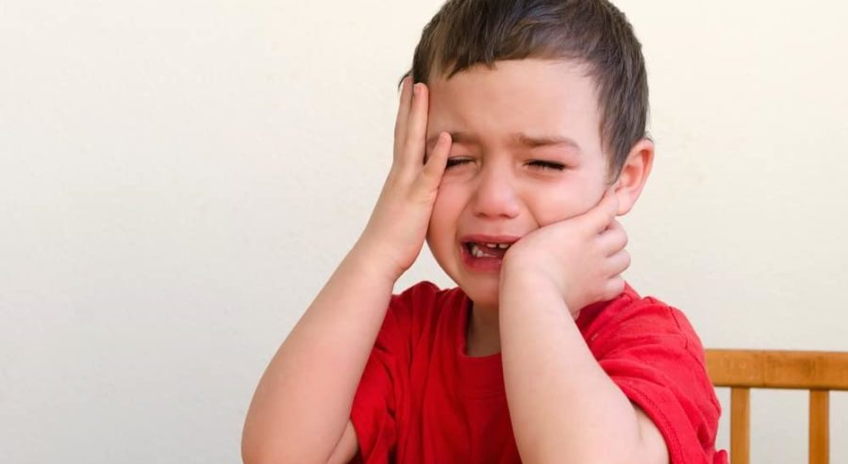
If we grab our friends hard, it hurts, and they will be sad.

Slide 10

We need to stop grabbing our friends.

Slide 11
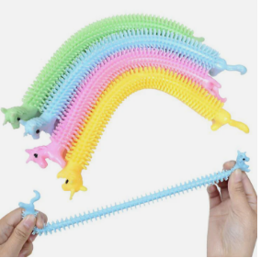
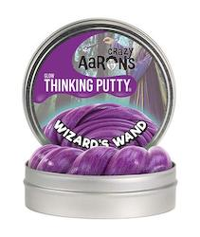
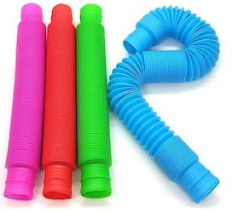
We stretch or squeeze our toys instead.

Slide 12

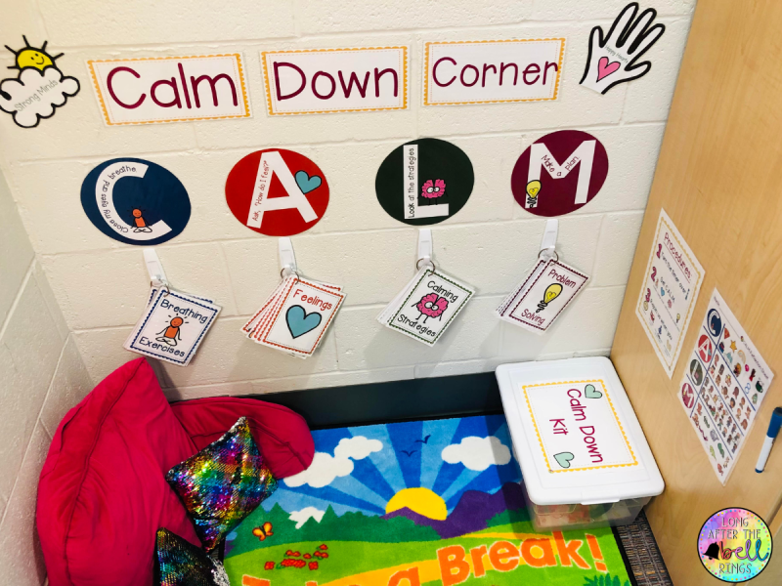
We can go to a calm down corner to calm my body

Slide 13
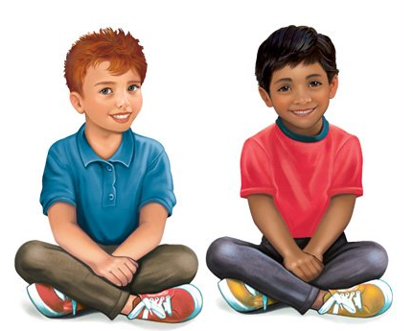
I must remember to keep my hands to myself.

Slide 14
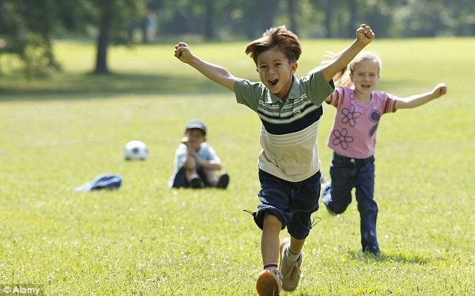
Then we can play happily together.

